Slide 1
Windows 10 IoT Core Introduction
Tomoya Yamanaka

Slide 2
Self-Introduction
Name: Tomoya Yamanaka
Home: Ortigas, Metro Manila, Philippines
Work： IT Engineer
Hobby: Attending/Organizing IT Events
Certifications:Microsoft Certified Trainer(MCT), and so on…
Role: Wankuma Alliance Manila Director
--We want more volunteer staffs!!
www.facebook.com/groups/WankumaAlliancePh/

Slide 3
Today’s topic
I’ll talk about how to start to use
Windows 10 IoT Core with Rasberry Pi 2/3.

Slide 4
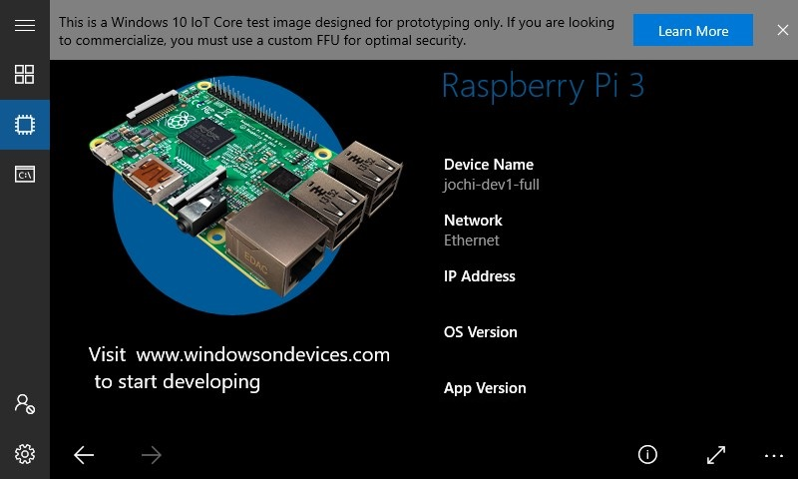
What is Windows 10 IoT Core?
Windows 10 IoT Core is a version of Windows 10 that is optimized for smaller devices with or without a display that run on both ARM and x86/x64 devices.
It can run on a cheap board-computer Raspberry Pi 2/3!
https://docs.microsoft.com/en-us/windows/iot-core/windows-iot-core

Slide 5
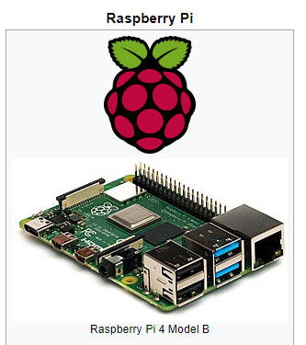
What’s Raspberry Pi
The Raspberry Pi is a series of small single-board computers developed in the United Kingdom by the Raspberry Pi Foundation to promote teaching of basic computer science in schools and in developing countries.
https://en.wikipedia.org/wiki/Raspberry_Pi

Slide 6
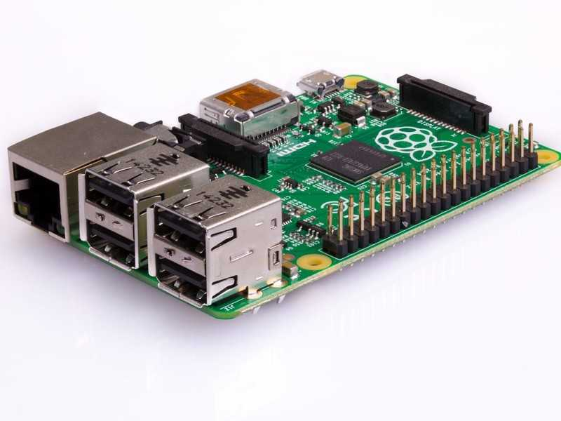
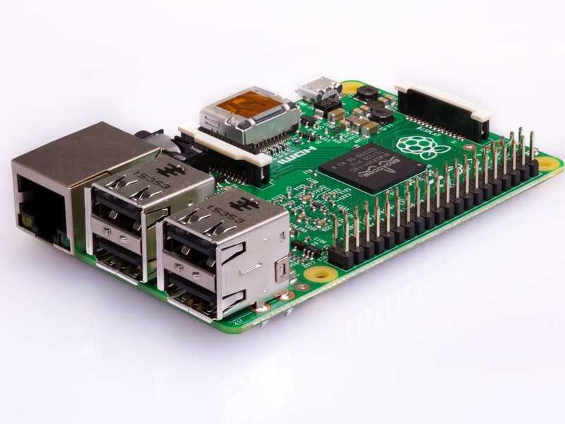
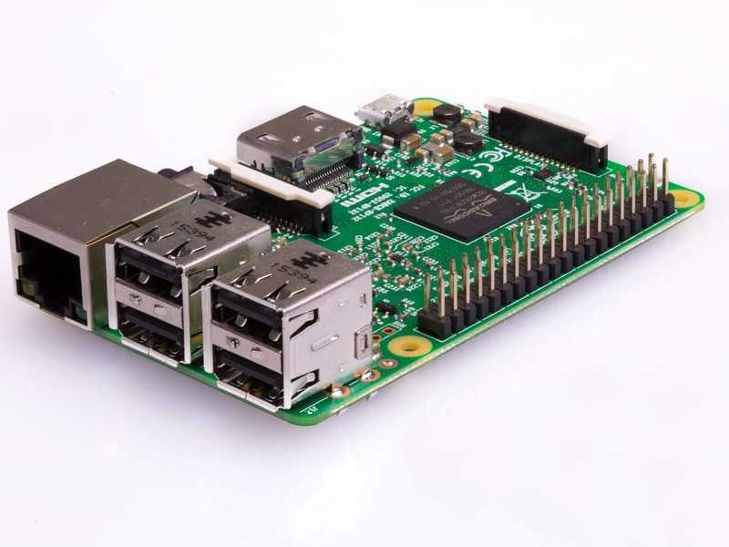
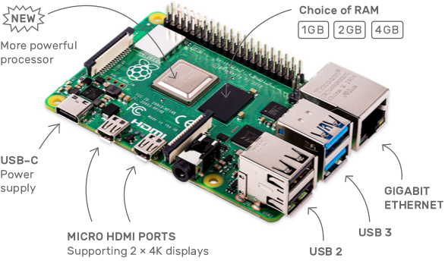
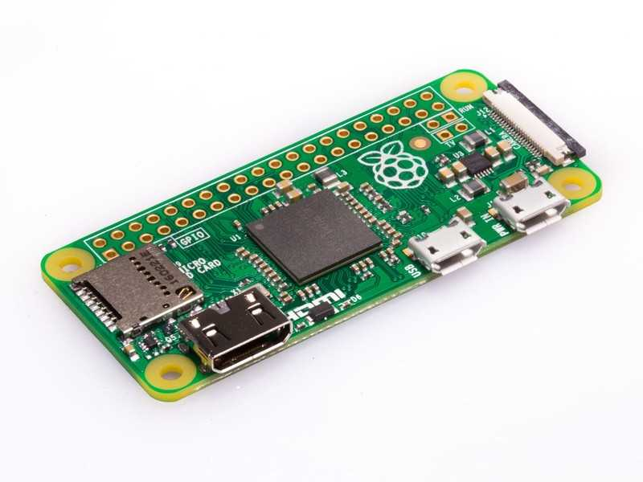
Variations of Raspberry Pi
There are many Raspberry Pi boards. The latest one is Raspberry 4 but I haven’t touch it yet.
Raspberry Pi
Raspberry Pi 2
Raspberry Pi 3
Raspberry Pi 4
Raspberry Pi Zero
https://www.raspberrypi.org/products/

Slide 7
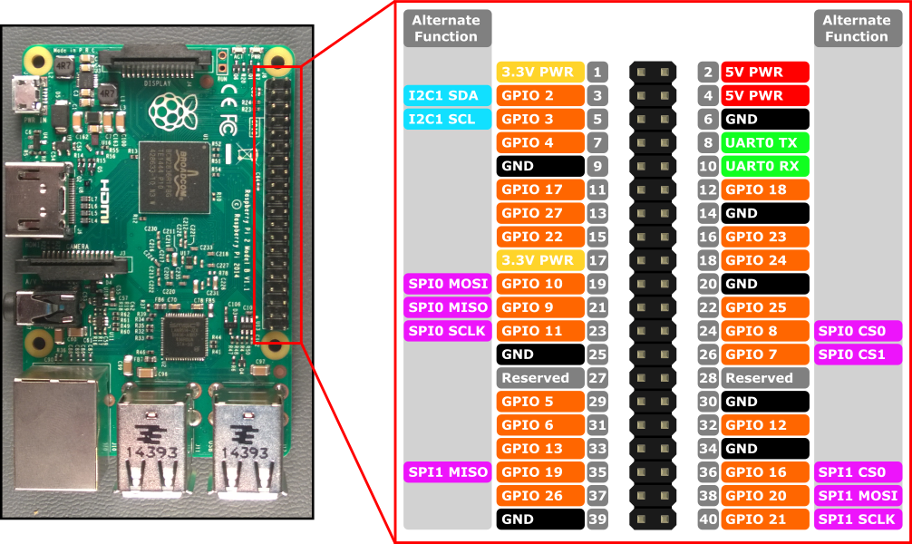
Raspberry Pi 2/3 Pin Layout
Each Raspberry Pi has GPIO, General Purpose In/Out, pins.
You can use they to connect and control other devices.

Slide 8
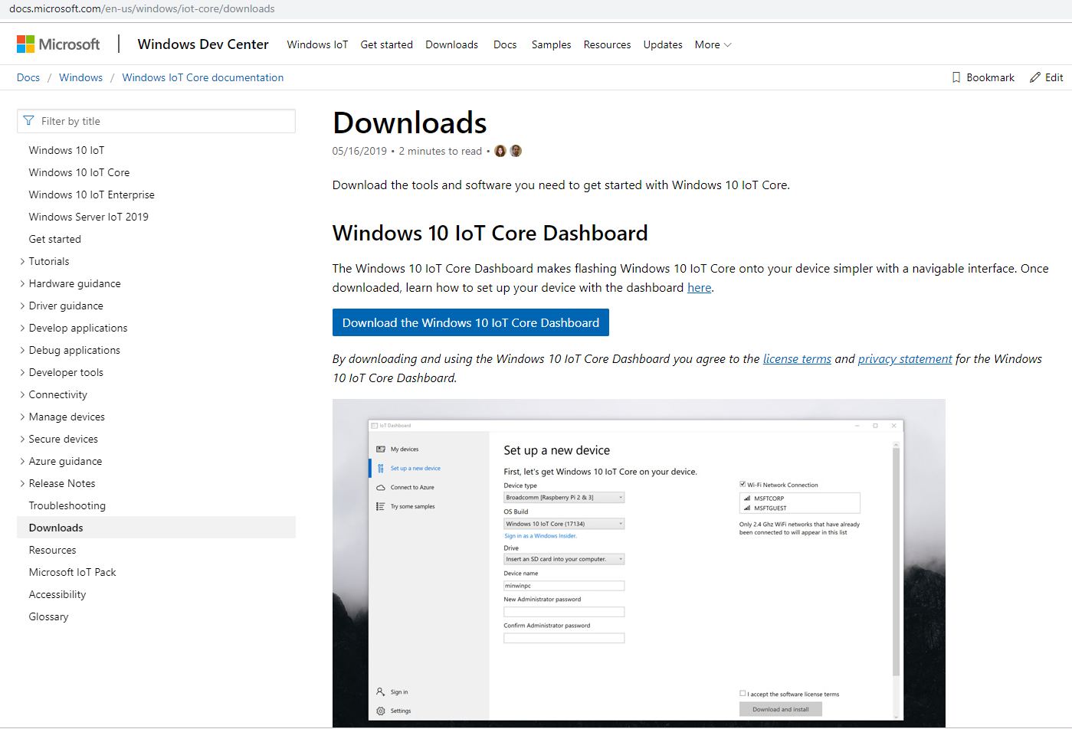
How to setup Windows 10 IoT Core?
You can flash the OS image through Windows 10 IoT Core Dashboard. It can be downloaded in following URL
https://docs.microsoft.com/en-us/windows/iot-core/downloads

Slide 9
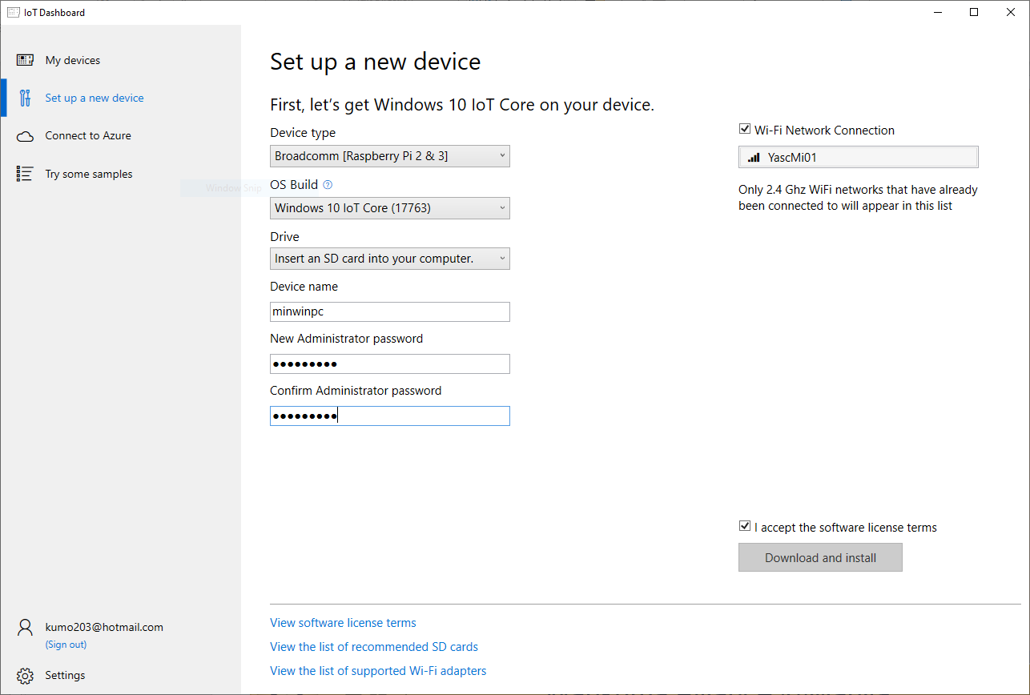
How to use?
With IoT Dashboard, you can setup the OS image flashed micro SD card in easy!

Slide 10
About Windows License Fee
The Windows 10 IoT Core operating system remains royalty-free.
https://blogs.windows.com/windowsexperience/2018/07/18/microsoft-announces-the-public-preview-of-windows-iot-core-services-today/

Slide 11
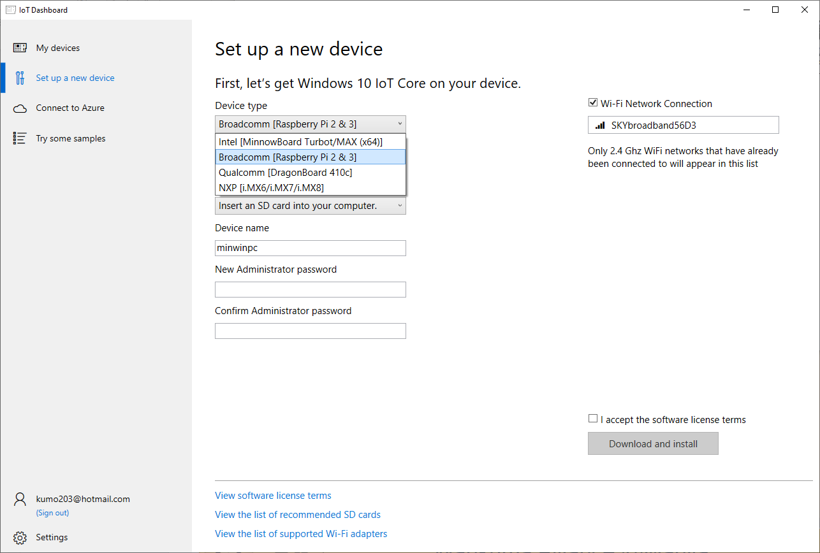
Other Choices
As other choices, MinnowBoard, DragonBoard, and NXPs are supported also. But more expensive and hader to find in a store.
And as one note, Raspberry Pi 4 is not supported yet.

Slide 12
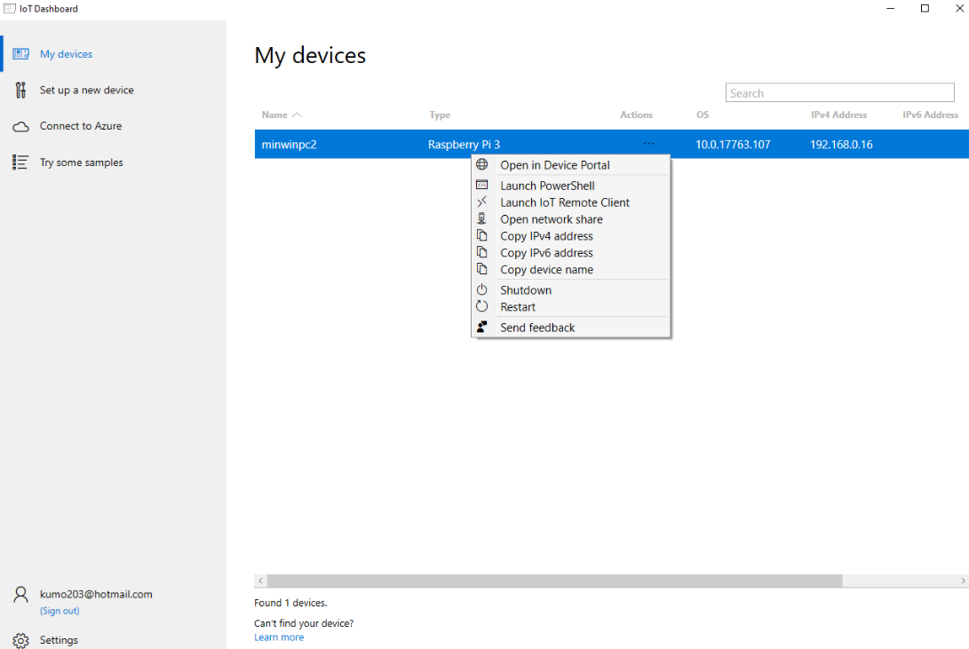
Remote Access
After setting up and start the new Windows 10 IoT Core device, you can access the devices through network with IoT Dashboard.

Slide 13
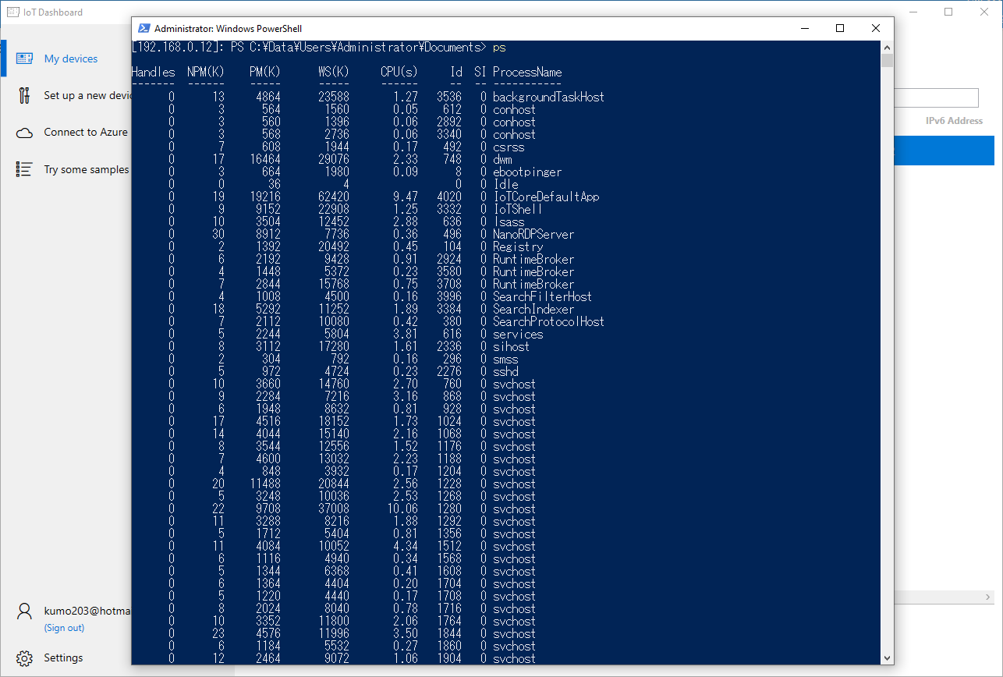
Remote Access
And you can open PowerShell prompt of the new device.
To sign in, Username is administrator and Password is the one you set.

Slide 14
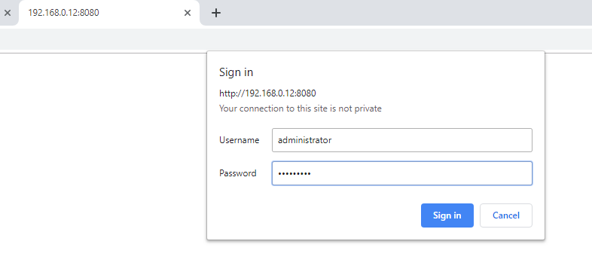
Device Portal
For remote access to Device Portal, you need to sign in. Username is administrator and Password is the one you set.

Slide 15
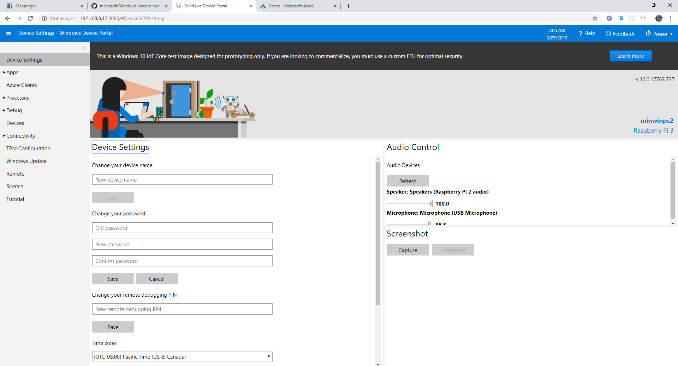
Device Portal
With Device Portal, you can do many actions such as password change, screenshot taking and many more!

Slide 16
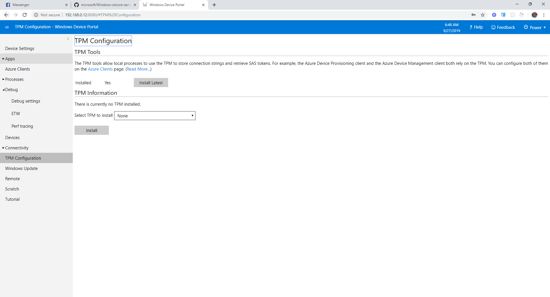
Device Portal
To register the device into Azure IoT Hub, TPM Configuration is needed.

Slide 17
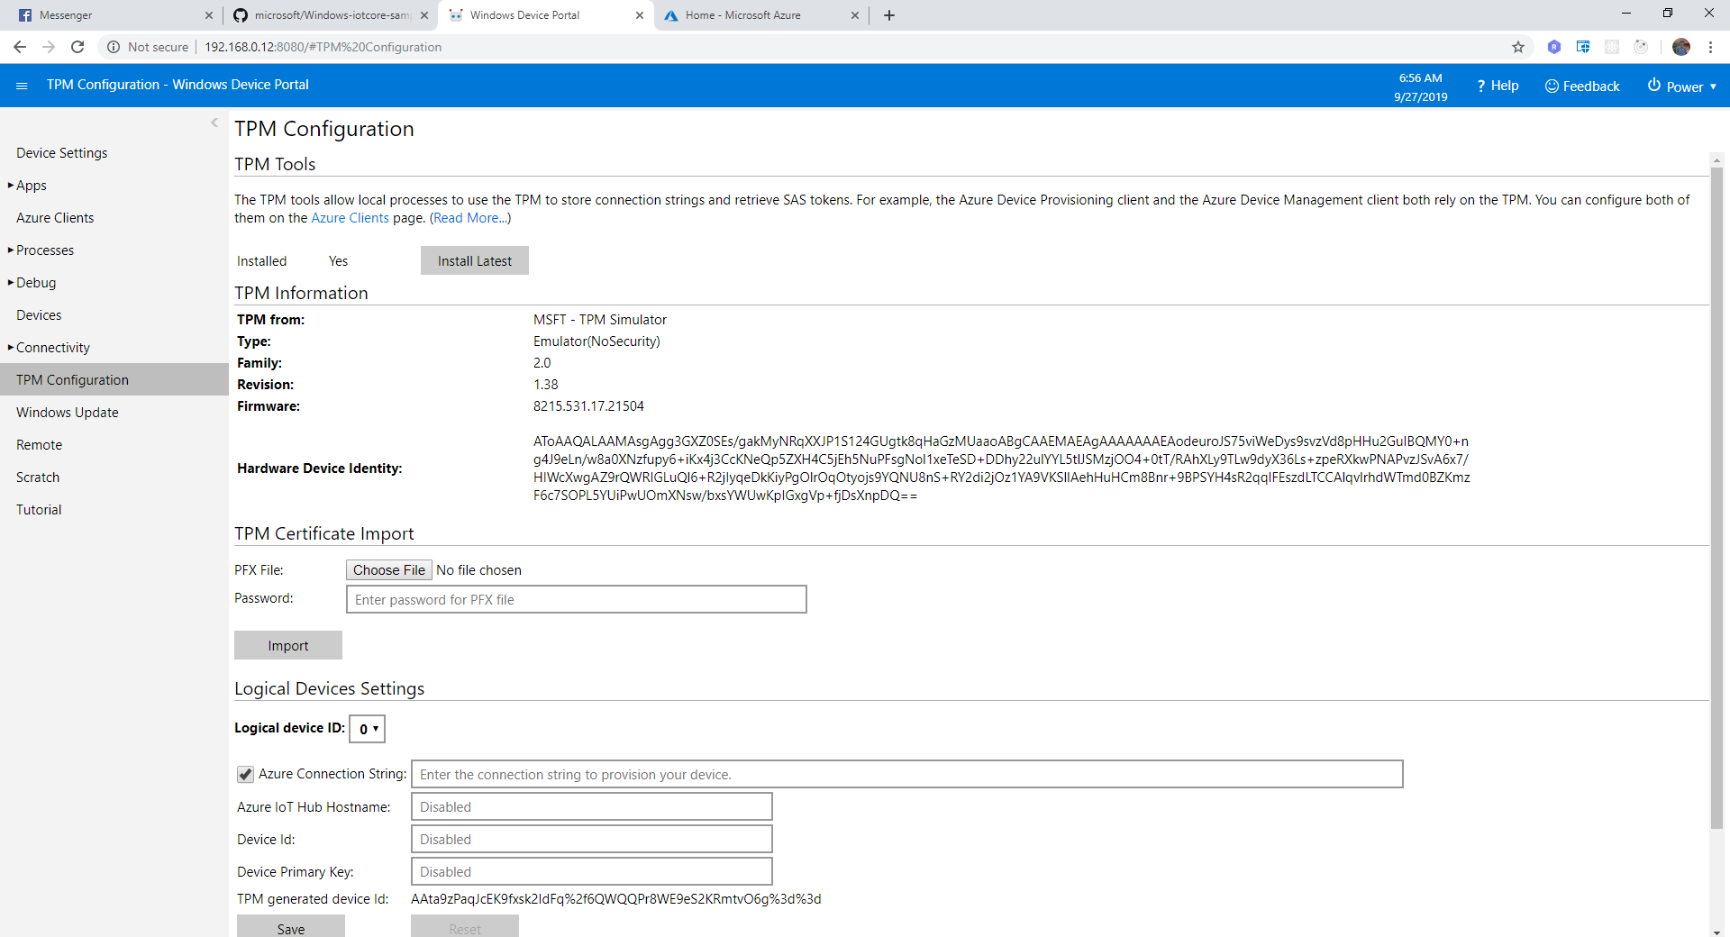
Device Portal
After setup TPM Configuration, the screen will become like following.

Slide 18
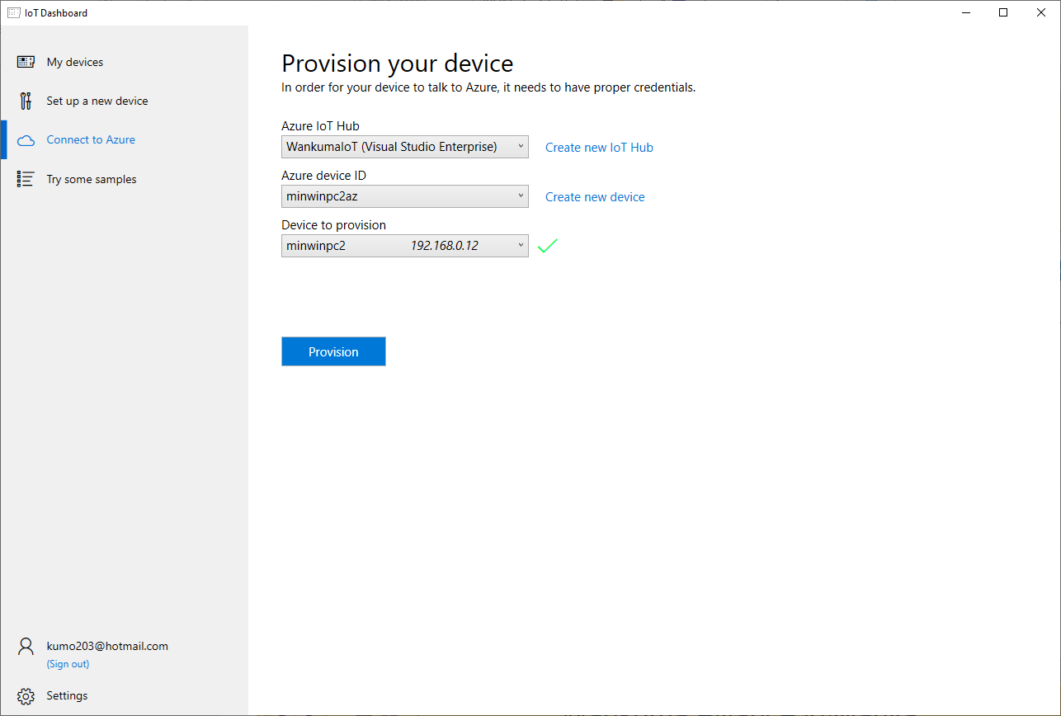
IoT Dashboard –Connect to Azure-
The Azure IoT Hub setup can be seen and manipulated from IoT Dashboard also.

Slide 19
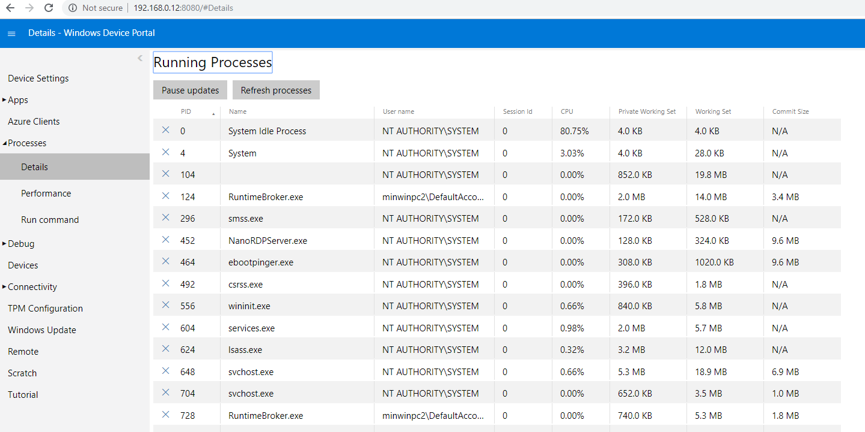
Device Portal
You can kill the process from Device Portal.
This will have important meaning later.

Slide 20
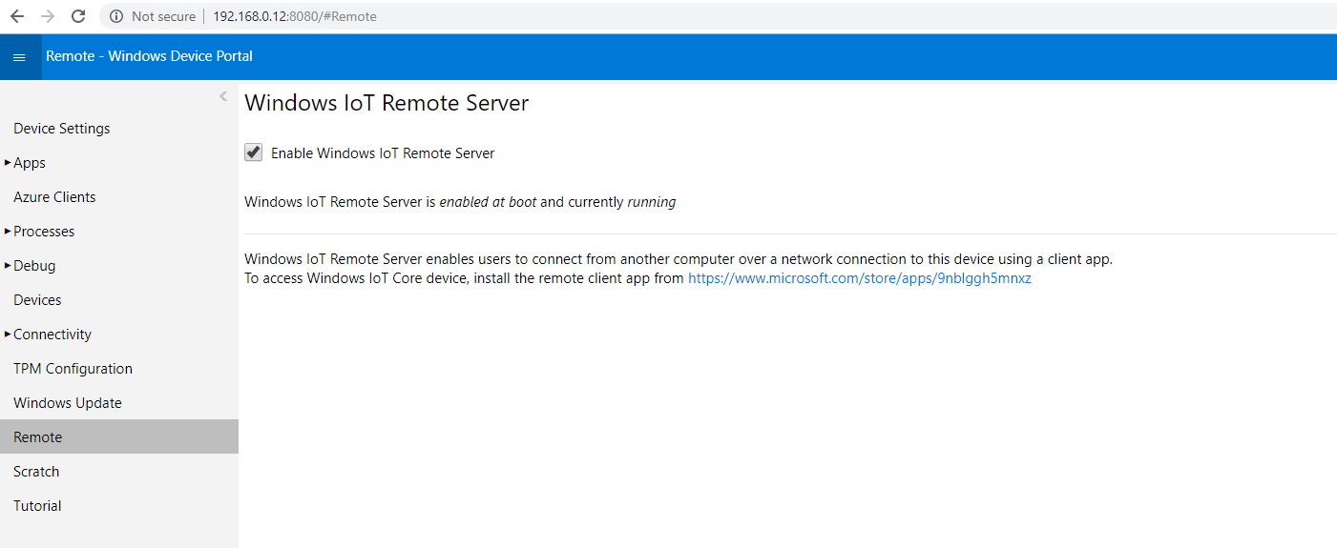
Device Portal
You can enable the device’s remote server. With doing this, you can use one Windows Store application.

Slide 21
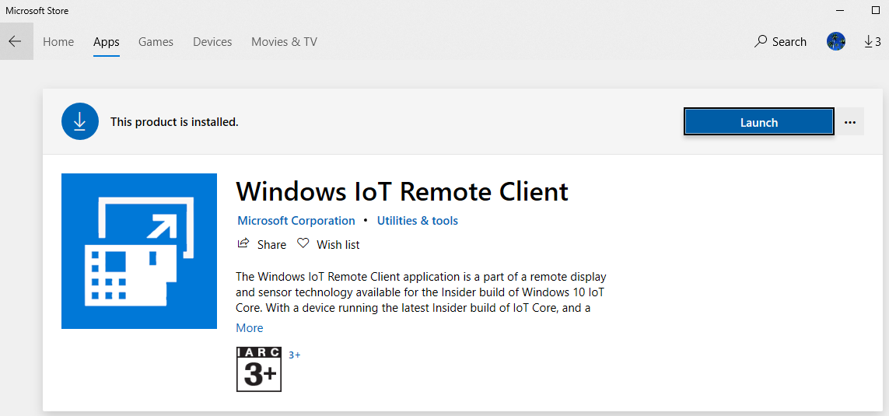

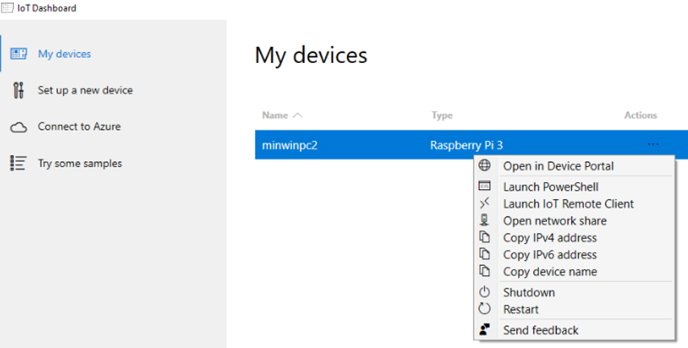
Windows IoT Remote Client
Windows IoT Remote Client can be launched IoT Dashboard.

Slide 22
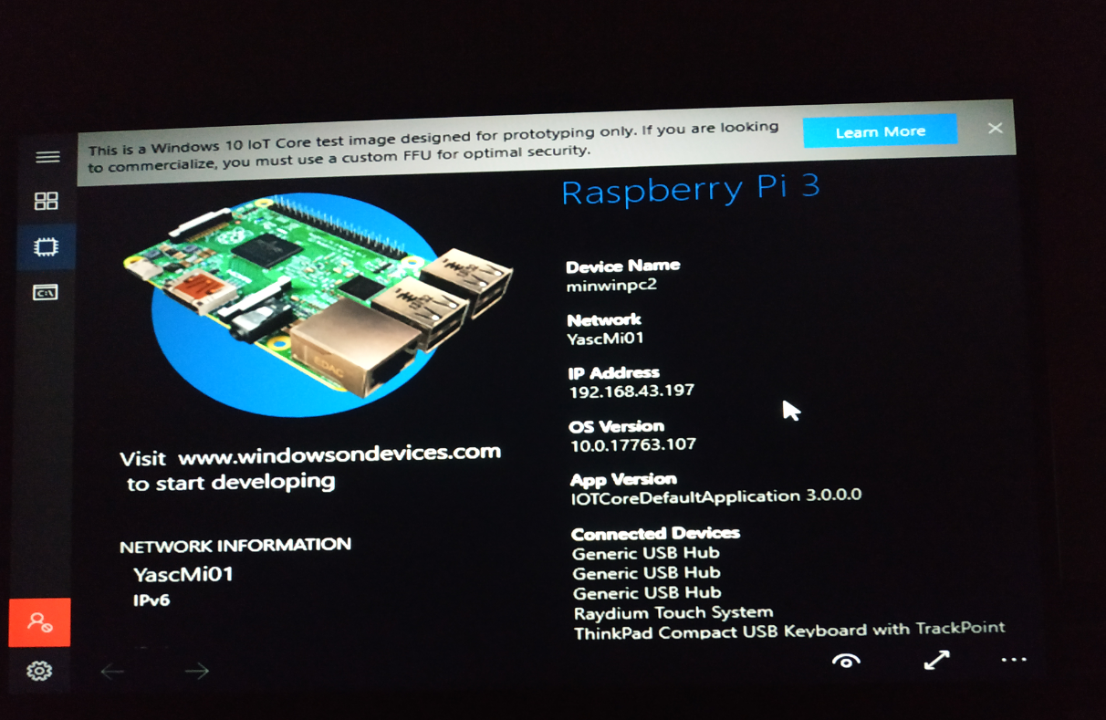
Windows 10 IoT Core Screens
With connecting a HDMI monitor and a USB power adapter to Windows 10 IoT Core image flashed micro SD card inserted Raspberry Pi, you can see its desktop screen.
But it takes some time to see after power-on.

Slide 23
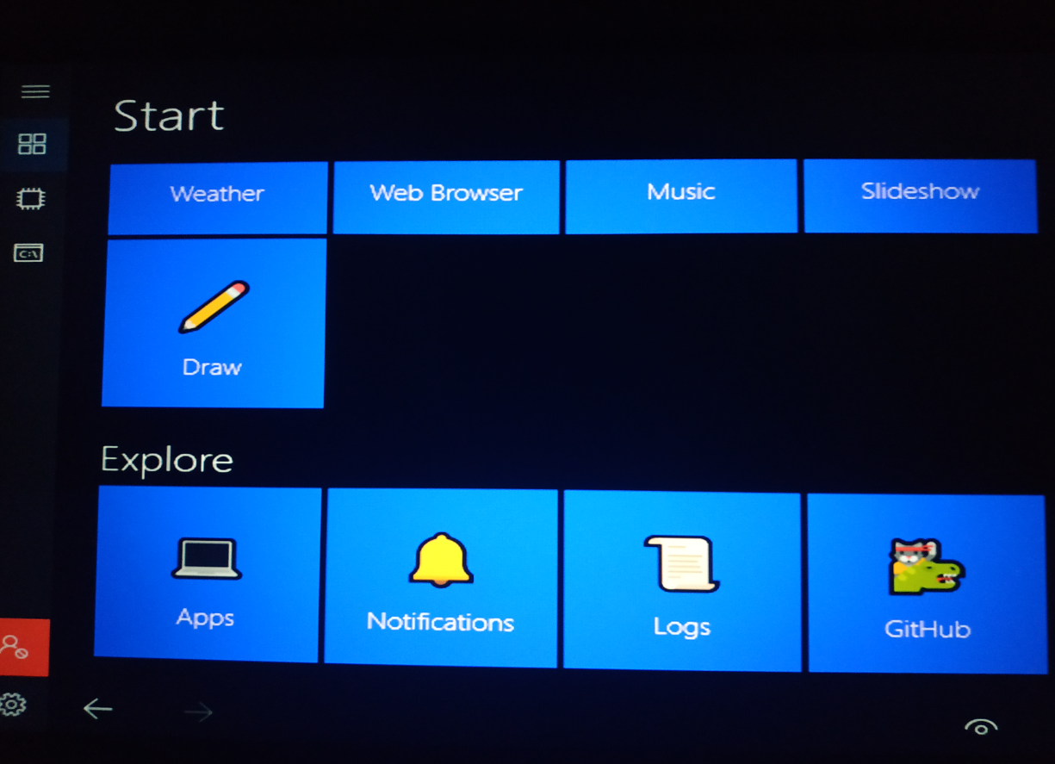
Windows 10 IoT Core Screens
You can open the windows menu.

Slide 24
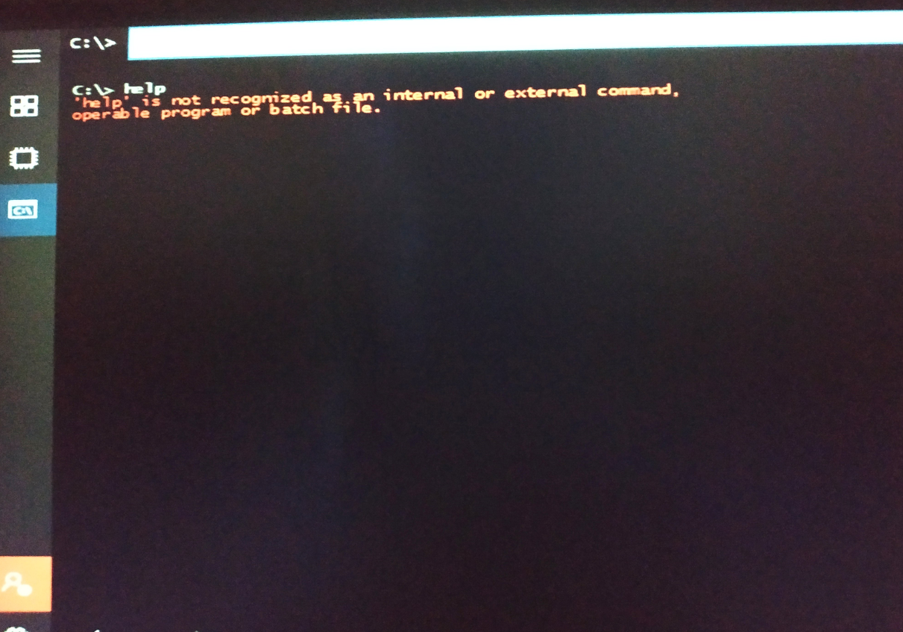
Windows 10 IoT Core Screens
And you can open the command-prompt. But not so useful…

Slide 25
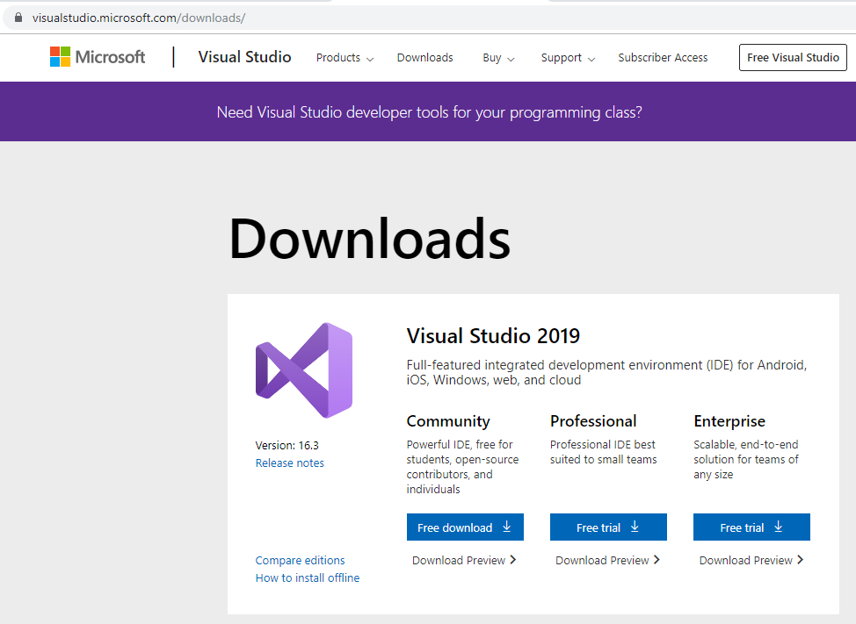
Windows 10 IoT Core Program Development
As you see the empty desktop, you will feel you want more programs. You can make it though Visual Studio.

Slide 26
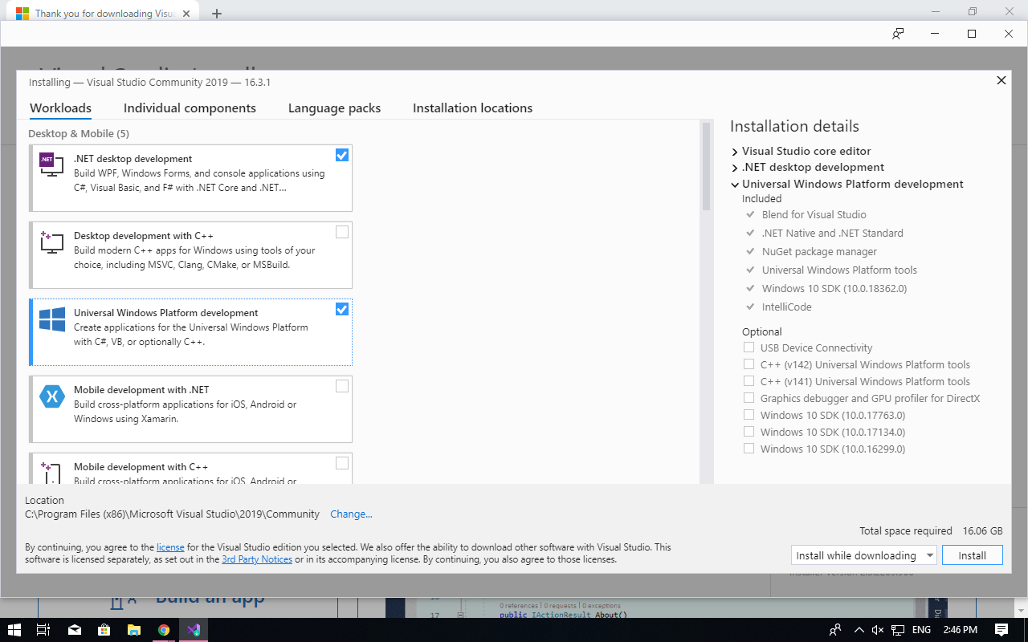
Windows 10 IoT Core Program Development
I chose following options in Visual Studio installation.

Slide 27
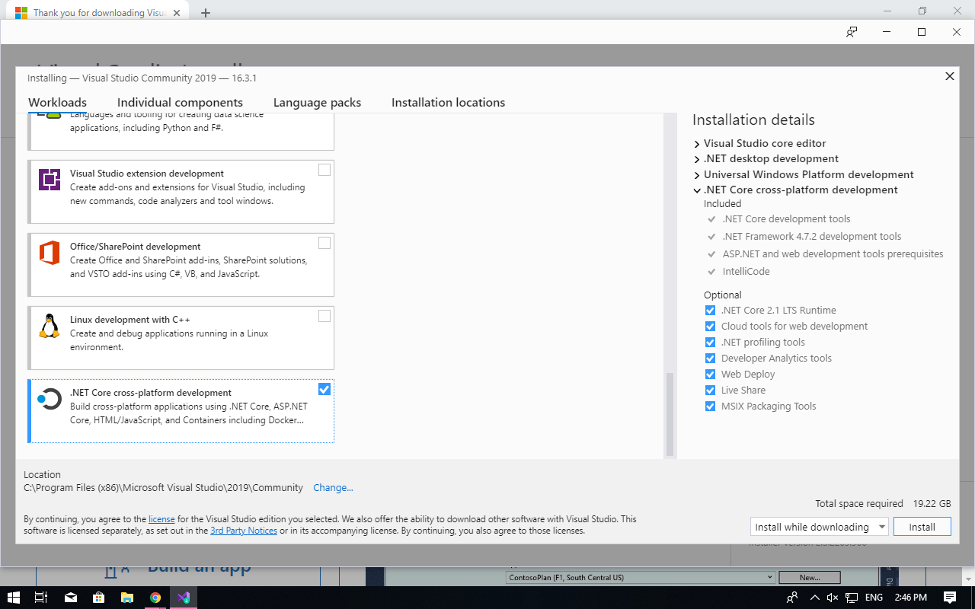
Windows 10 IoT Core Program Development
I chose following options.

Slide 28
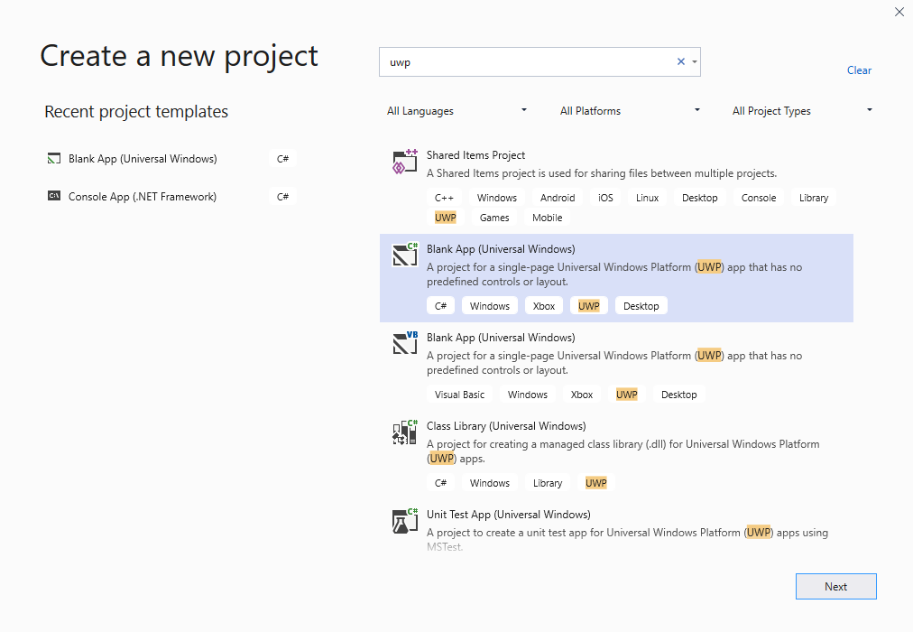

Windows 10 IoT Core Program Development
After installation and run Visual Studio, you need to create a new project from many choices. UWP, Universal Windows Platform, App is the correct choice.

Slide 29
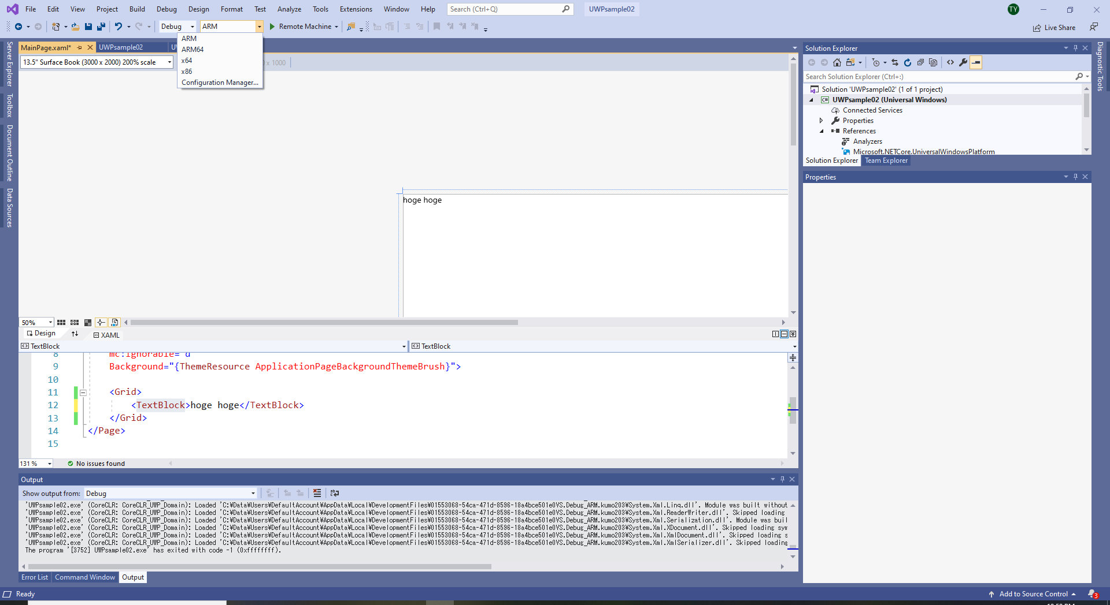
Windows 10 IoT Core Program Development
After creating a new UWP app project, you need to change the build setting to ARM to deploy your program to Raspberry Pi device.

Slide 30
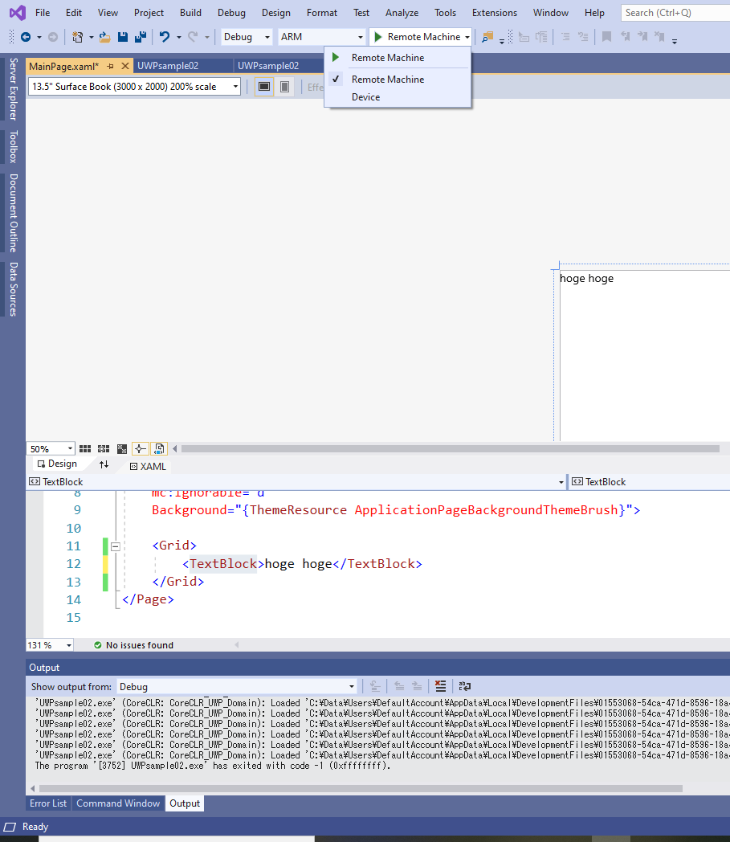
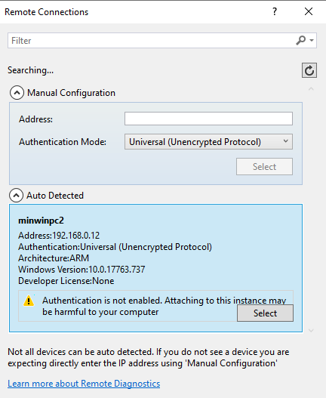
Windows 10 IoT Core Program Development
And to do a remote debug, you need to change the target from Local Machine to Remote Machine

Slide 31
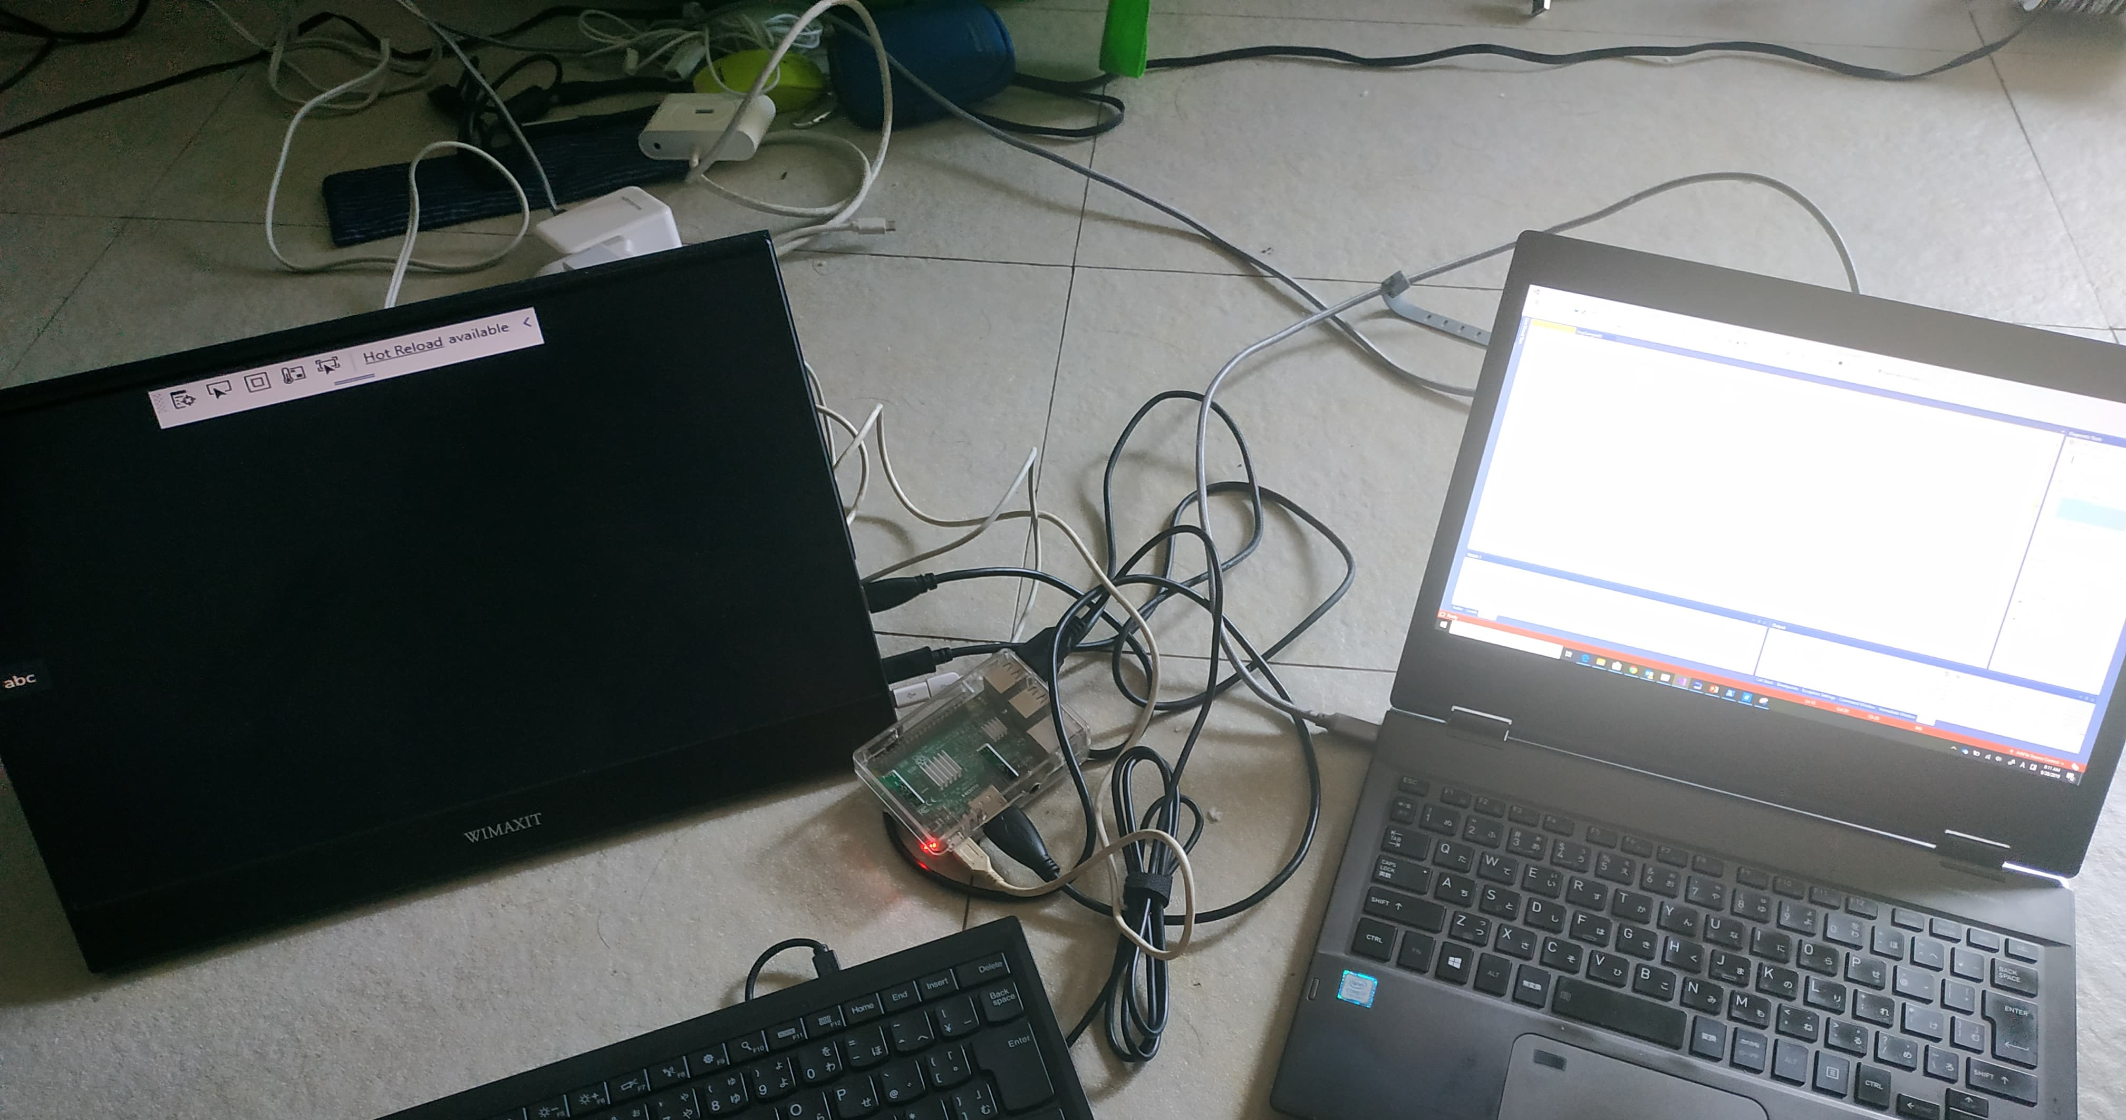
Windows 10 IoT Core Program Development
With the remote debug, you can do as if you are debugging in local. Even live time UI edit is possible.

Slide 32
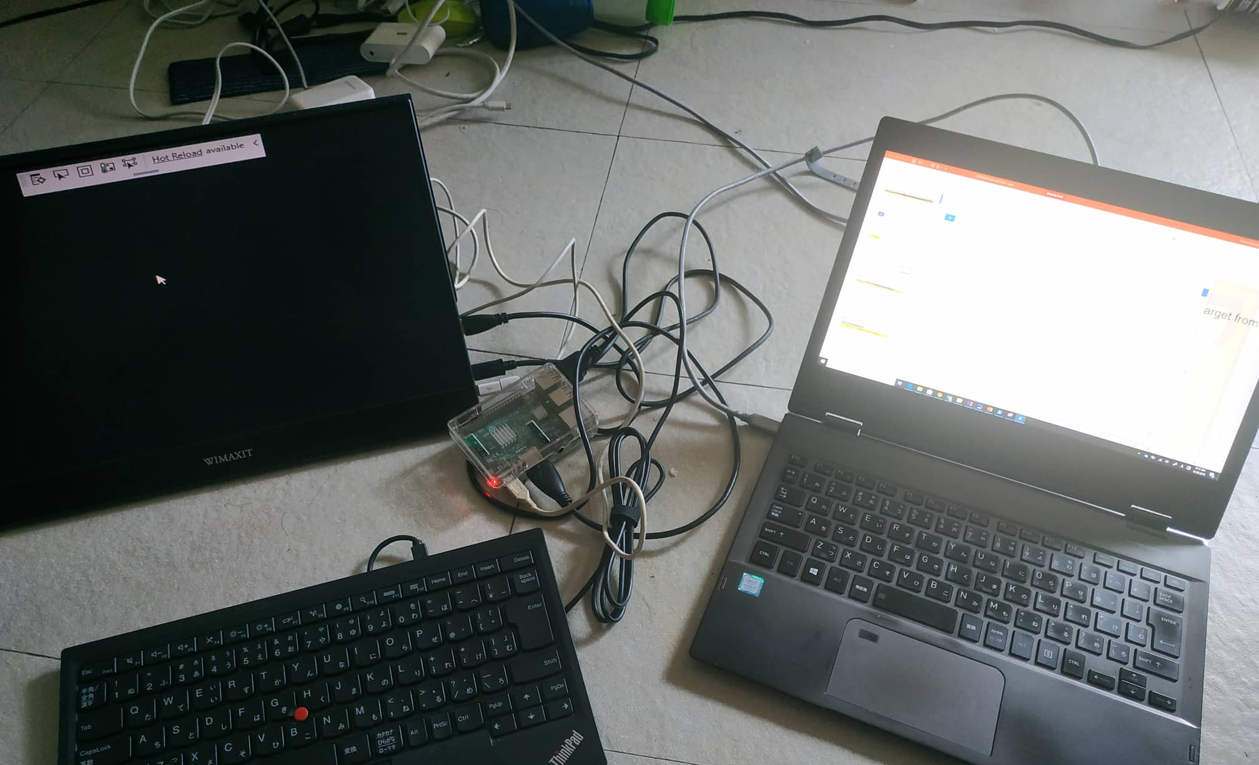
Windows 10 IoT Core Program Development
Windows IoT Remote Client app is also useful for debugging.

Slide 33
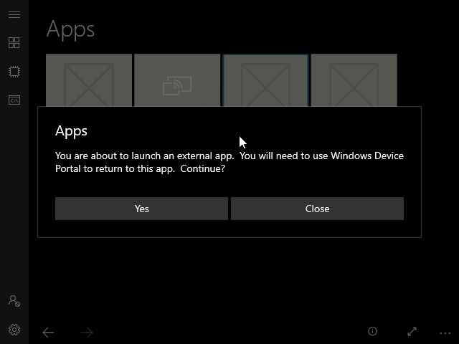
Windows 10 IoT Core Program Development
After debugging, you can use the program. It’s in the device start menu In Start -> Apps already. But you after starting the program you cannot stop it from the device’s screen unless you implement exit button. It’s very much for kiosk like usage.

Slide 34

Windows 10 IoT Core Program Development
For further development, MS is providing lots of sample app projects.
https://github.com/microsoft/Windows-iotcore-samples/

Slide 35
Conclusion
Windows 10 IoT Core and Raspberry Pi combination is easy to start IoT programmable platform.
You can use Visual Studio to make and debug your program so for especially Windows programmer it’s attractive.
Why don’t you try?

Slide 36
END

